Slide 1

Web Scraping
ANALYSIS OF APARTMENT PRICES
Website: MagicBricks.com
Batch → 191

Slide 2
INTRODUCTION TO THE WEBSITE:
MagicBricks.com is a Real-estate website with services included Buy, Rent, Sell properties.
The website provides home loans and property services is a full stack service provider for all real estate needs
The website provides MB membership which includes exclusive privileges, it is user friendly and easy to understand and go through
It is also having a chat assistance available which helps in case of difficulty.

Slide 3
AGENDA: Flow of the ppt
Problem Statement
Objective of the Project
Web Scraping – Details (Websites, Processor you followed)
Summary of the Data
Exploratory Data Analysis:
Data Cleaning Steps
Data Manipulation Steps
Univariate Analysis Steps
Bivariate Analysis Steps
Multivariate analysis
Key Business Question
Conclusion (Key finding overall)
Q&A Slide
Your Experience/Challenges working on Web Scraping – Data Analysis Project

Slide 4
About me:
Name: G.Raguwing
Qualification: B.Tech From IARE
As we all know that we are living in a Data-Driven world, Any business, big or small is looking for skilled people in the field of Data-Science who can comprehend and deconstruct data. It is the very reason that, I would like to learn Data-Science. I believe it is a good career transition.
Experience: Fresher
Name : P.Sri Sai Sathvik
Qualification: B.Tech From GITAM
As we all know that we are living in a Data-Driven world, Any business, big or small is looking for skilled people in the field of Data-Science who can comprehend and deconstruct data. It is the very reason that, I would like to learn Data-Science. I believe it is a good career transition.
Experience: Fresher

Slide 5
Problem Statement
A problem statement is the clear description of the problem that you are trying to solve based on the client’s insight. This will be the starting point for decision making.
Key Problem statements:
What are the Areas having most no of properties?
What is the factor that is affecting the price of the property?
Why do we need to look at the Carpet Area as in client’s best interest?
How to identify the number of apartments based on Carpet Area and price, also on the City that the client

Slide 6
Objective Of The Project
Flats/Apartments price analysis based on several factors over cities.

Slide 7
Web Scraping Details:
Website scraped: MagicBricks.com
Link :https://www.magicbricks.com/flats-in-mumbai-for-sale-pppfs
Libraries/Techniques used:
Data Collection → BeautifulSoup, requests, RegX.
Data Cleaning → Pandas, Numpy.
Data Visualization → Matplotlib, Seaborn.

Slide 8
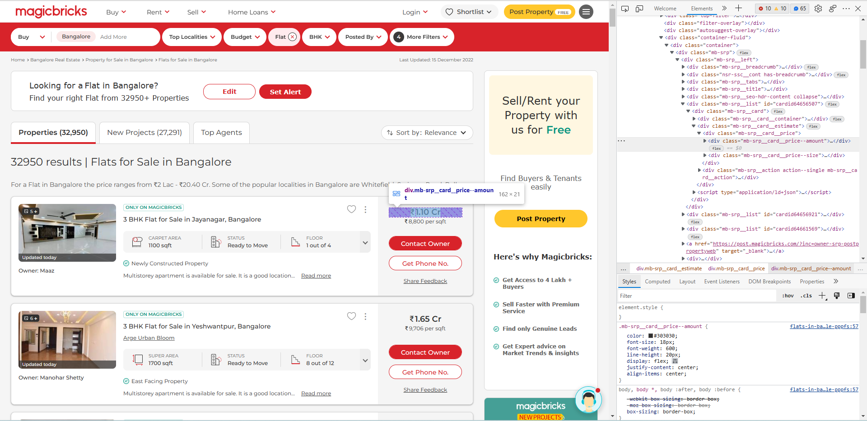
WEBSCRAPPING

Slide 9
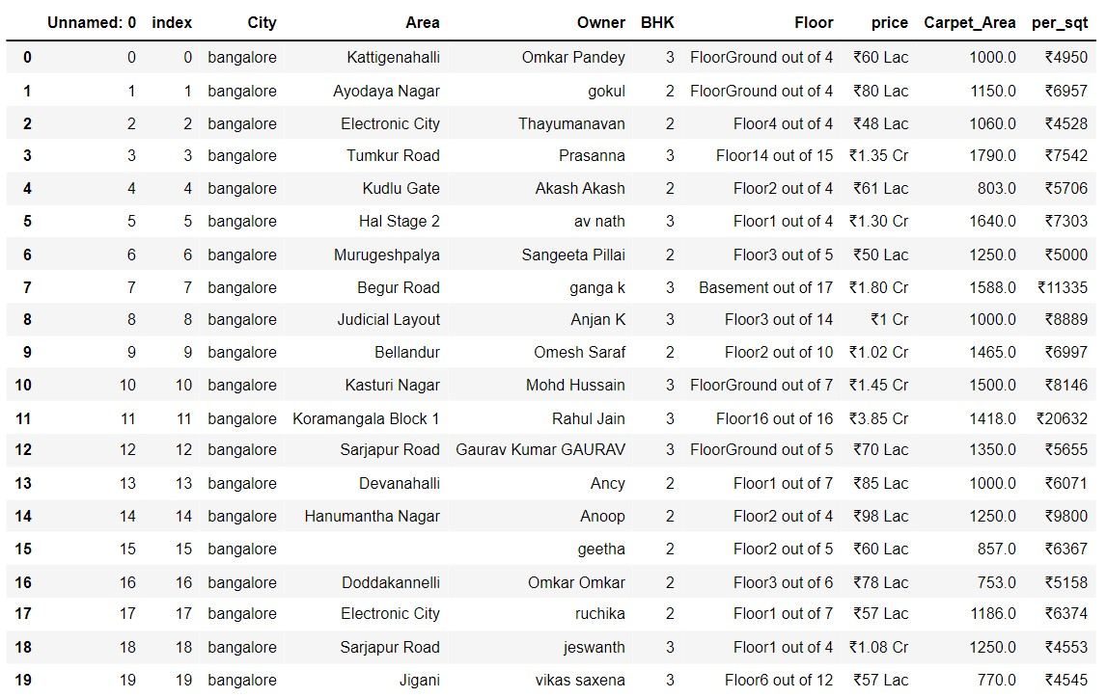
Raw Data Collected:

Slide 10
Summary Of The Data
The Data-Collected is a raw data from MagicBricks.com which contains Null-Values(NaN’s), Empty spaces and Corrupted data. The total number of rows obtained are 420 and columns are 8.
Initially the Data will be of dtype → object, we need to clean the data and convert them into their respective dtypes.
The Column Variables are:
1. City
2. Area
3. Owner
4.BHK
5.Floor
6.Price
7.Carpet_Area
8.Per_sqt

Slide 11
EDA → Exploratory Data Analysis
HISTORY OF EDA:
The term EDA is defined by Turkey in 1961 as: “ Procedures for Analyzing data, techniques for interpreting the results of such procedures, ways of planning the gathering of the data to make it’s analysis easier, more precise or more accurate”.
John W.Turkey wrote the book exploratory data analysis in 1977.
What Is EDA:
An essential step in any Dataset analysis , It provides a base for breaking down problem statement using various techniques mostly graphical(Data Visualization) for better understanding of the dataset.
The primary aim of the EDA is to open-mindedly explore the data to find insights, leads or clues that generate hypothesis for the problem statement.
EDA plays a crucial role in understanding the 3 characteristics of Problem Statement :
→ Why do we need a problem statement.
→ What is the problem statement.
→ How to resolve the problem statement.

Slide 12
Data Cleaning Steps:
Data Cleaning Involves the following steps:
Step 1: Check for Duplicates:
Find the Duplicates and drop them, keep preference as first.
Step 2: Identify the Corrupted Data:
Remove the Corrupted values, symbols or text etc..,
Step 3 : Handling missing values:
Identify missing values using `isna()` or `isnull()`
View the missing values
Replace the missing values after changing the dtypes of the columns with respective Mean(), Median(), Mode().
Step 4 : Handling Outliers:
Find the skewness for each column and based on the value move forward.
Identify the Outliers using IQR method or Z-score method and view them.
Step 5: Treating Outliers:
Either Drop the Outliers if they have no effect on your Data Frame.
Do the 4 Transformation techniques that are available to reduce the outliers to use it as a new column for better visualization.

Slide 13
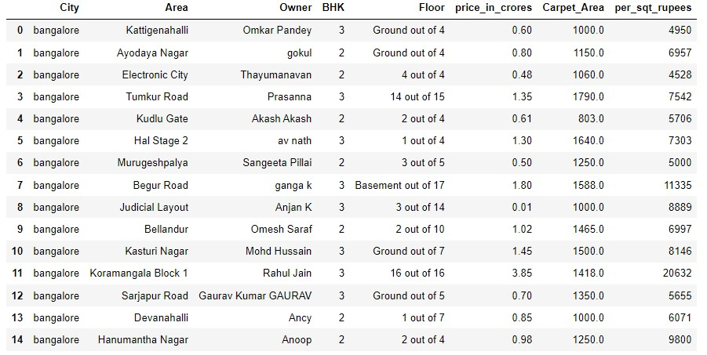
Cleaned Data:

Slide 14
Data Manipulation
Data Manipulation contains the following steps:
Type Casting of Data Frame columns to the respective dtypes.
Filtering the Dataset according to the need for better understanding.
Data Frame operations like `Column Renaming`, `Dropping rows and columns`, `Resetting index` etc..,
Sorting the data in a data frame.
Applying string operations, Array operations , list operations etc.., on the data.

Slide 15
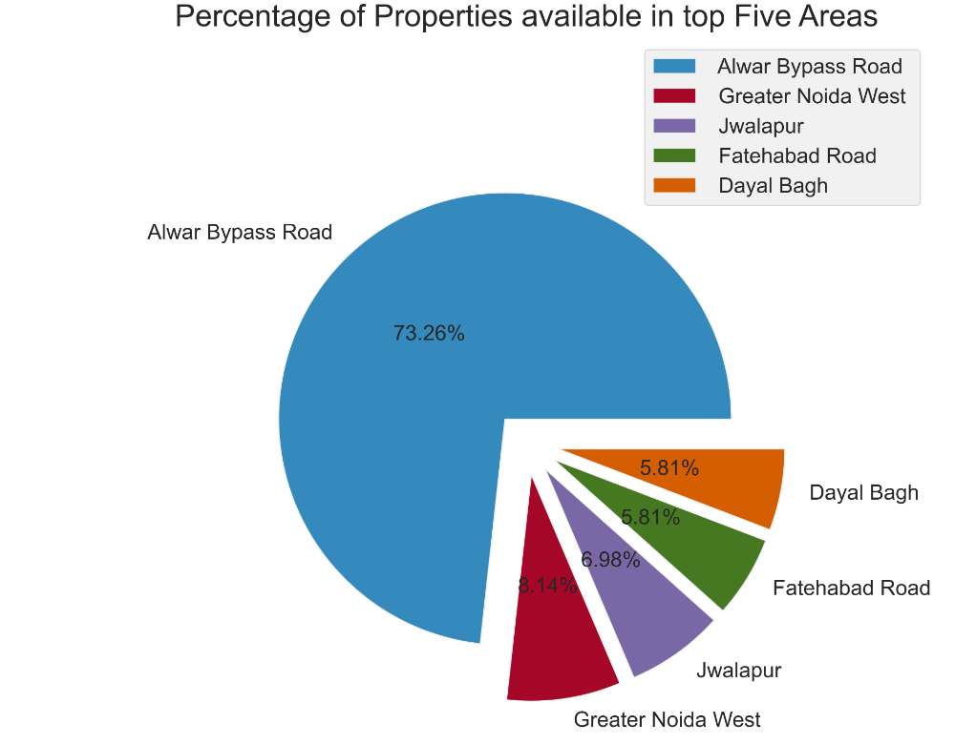
Univariate Analysis
The analysis of single variable at a time with the aim of analyzing the distribution of the variable in the data often equated with descriptive analysis.
Observation:
Each slice in the following pie chart represents the percentage of overall properties available in top 5 area’s in my dataset, It is observed that Alwar Bypass Road is having more no of properties.

Slide 16
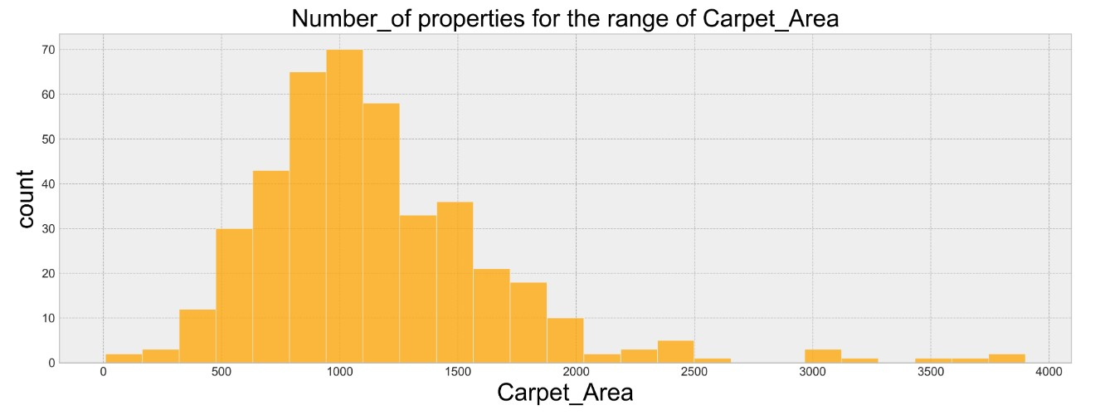
Observation:
1. From the above histogram it is observed that up to 70% of the apartments are lie between the Carpet Area 500 – 2000 Sqft.
2. There are few properties which are greater than 2000 Sqft which are not outliers in this case.

Slide 17
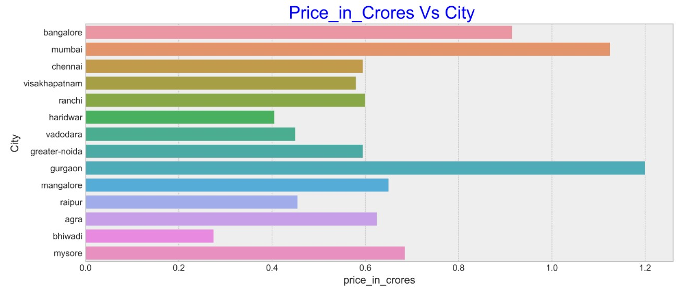
Bivariate Analysis
The statistical analysis of two variables at a time in which one variable is dependent and the other is independent.
1. The bar plot will enlighten us regarding the price analysis based on cities, As said it is observed that Gurgaon is having highest price for apartments
2. Bhiwadi is having least price for apartments

Slide 18
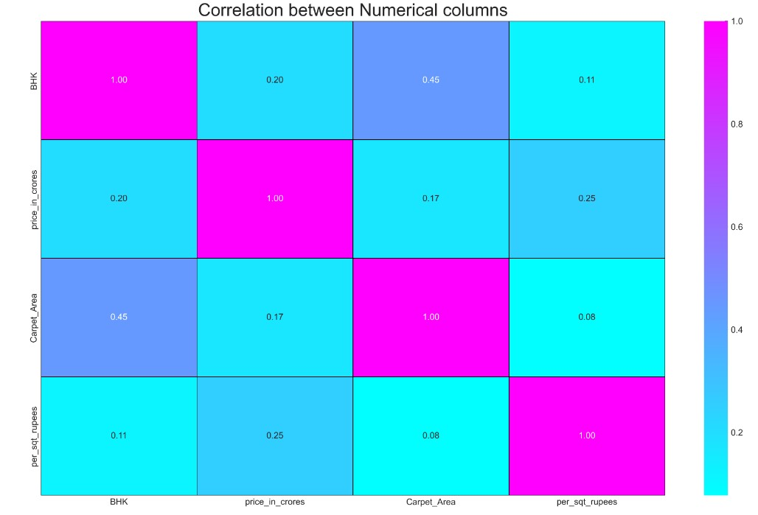
Heat Map:
Observation:
BHK Vs Carpet Area is having positive correlation as you can see in the heat map
as BHK increases the carpet area also increasing.
2. Per Sqft rupees vs. price in crores is also having little bit of positive correlation.
3. Per Sqft rupees vs. carpet area having high negative correlation.

Slide 19
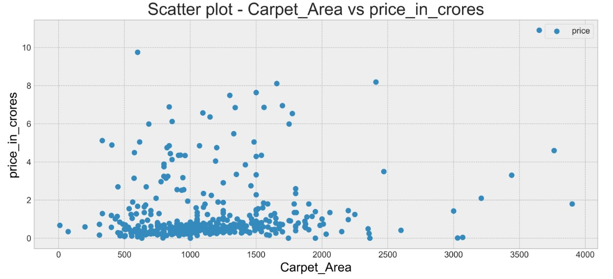
Observation:
The above Scatter plot clearly shows us that more no of apartments fall under the price range of 0 to 2 crore and carpet area 500 – 2000 Sqft.
The apartments that are having price >2 crore are high valued properties based on BHK and the location and city there are present in.

Slide 20
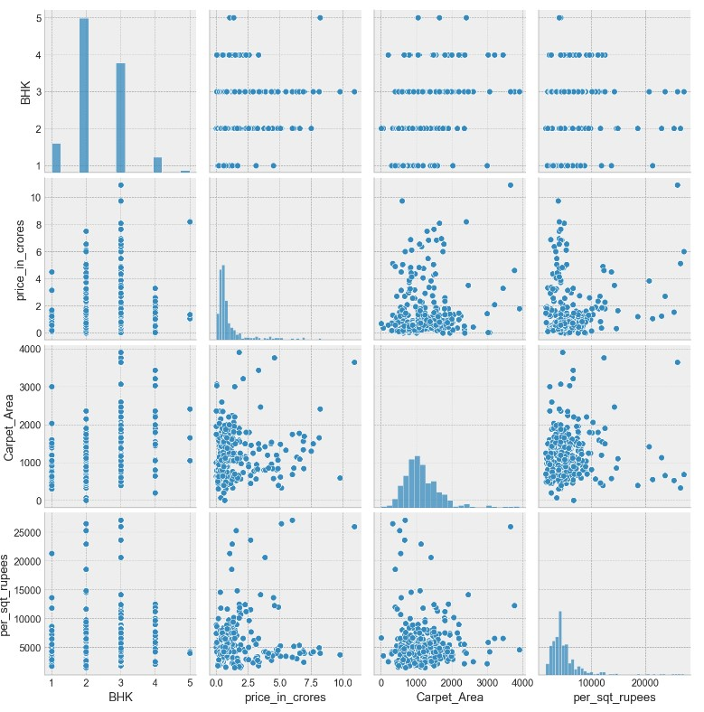
Multivariate Analysis
The analysis of more then 2 variables(Numerical) at a time concerned with the inter relationship between the variables.
Observation:
Pair plot visualizing the relationship between all the numerical columns available in my dataset, we can observe that wherever the column matches we have a nice bar plot/ Histogram else where we get the relational plot b/w respective columns.

Slide 21
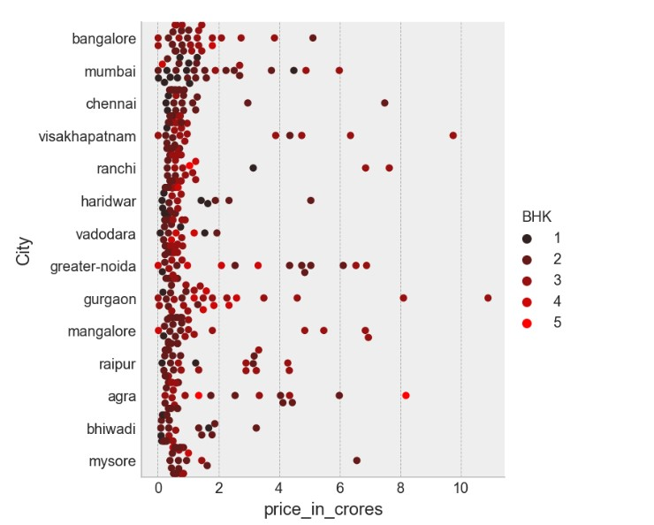
Relational plot: Cat plot(kind: Swarm)
Observation:
In the Relational plot we can observe that How the BHK is influencing the price of the apartments based on different cities.
Also we observe higher BHK’s having more influence on the price.

Slide 22
CONCLUSIONS:
From the EDA and Data Visualization the following conclusions are drawn:
1. Alwar Bypass Road Area in Alwar District having more no of Flats/Apartments
73.26% of the overall dataset.
2. From the above analysis Gurgaon city is having highest price range for Flats/Apartments and Lowest in bhiwadi city.
3. It is concluded that up to 60% of the Flats/Apartments are off 2BHK and in the price range of 0 to 2 crore.
4. Up to 90% of the Flats/Apartments are having a carpet area range of 500 – 2000 Sqft.
5. Based on the EDA ,Data visualizations and conclusions that are drawn I believe it is clear that my client can comfortably find the Flat/Apartment of his financial factors.

Slide 23
Q & A Slide

Slide 24

THANK YOU

